Slide 1
EEE283
Digital Logic Design
Course Instructor: A K M Anindya Alam

Slide 2
Topic 8:
Sequential Circuits 1 (Latches and Flip Flops)

Slide 3
Sequential Circuits
Outputs of sequential logic depend on current and prior input values – it has memory.
Some definitions:
State: all the information about a circuit necessary to explain its future behavior
Latches and flip-flops: state elements that store one bit of state
Synchronous sequential circuits: combinational logic followed by a bank of flip-flops
EEE282
EEE283

Slide 4
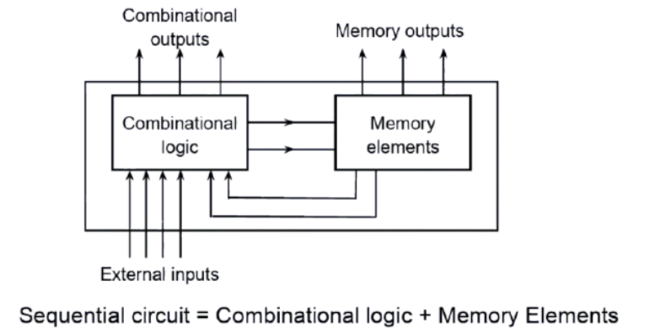
Sequential Circuits
A sequential circuit consists of a feedback path, and employs some memory elements.
EEE282
EEE283

Slide 5
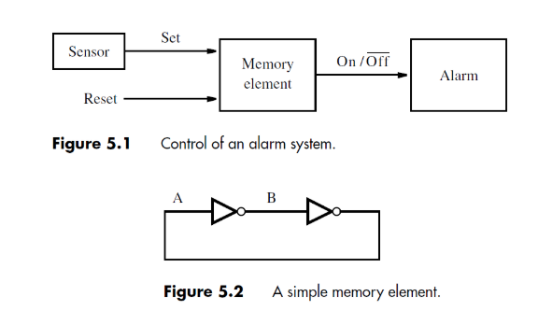
Memory Elements
EEE282
EEE283

Slide 6
State Elements
The state of a circuit influences its future behavior
State elements store state
Bistable circuit
SR Latch
D Latch
D Flip-flop
EEE282
EEE283

Slide 7
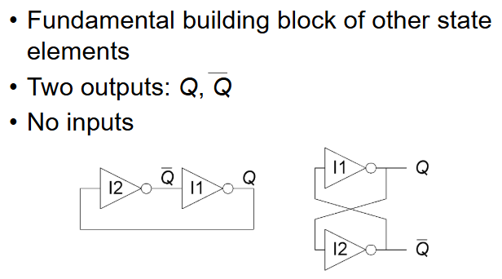
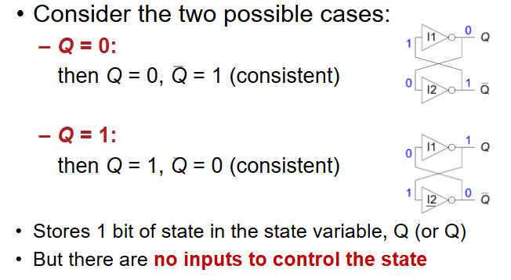
Bistable Circuits
EEE282
EEE283

Slide 8
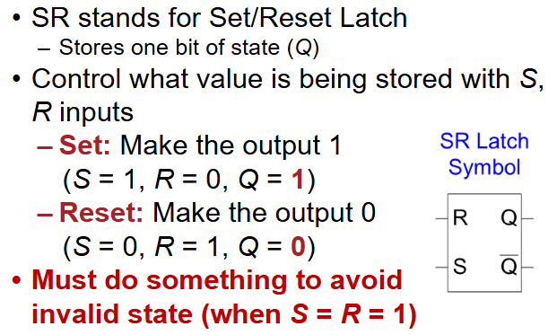
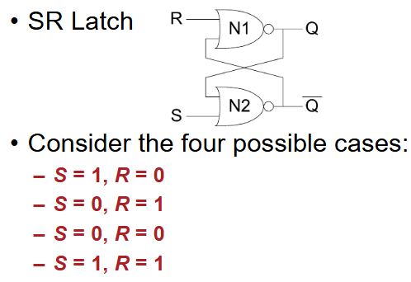
Set-Reset (SR) Latch
EEE282
EEE283

Slide 9
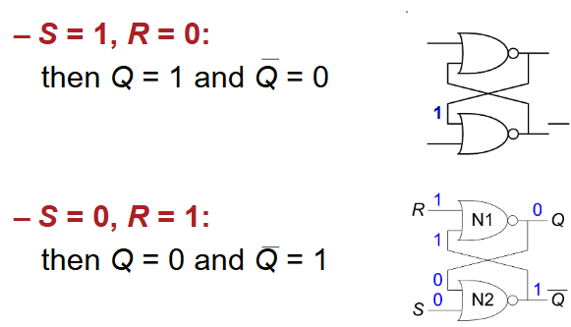
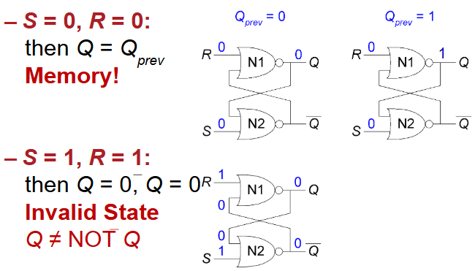
Set-Reset (SR) Latch
EEE282
EEE283

Slide 10
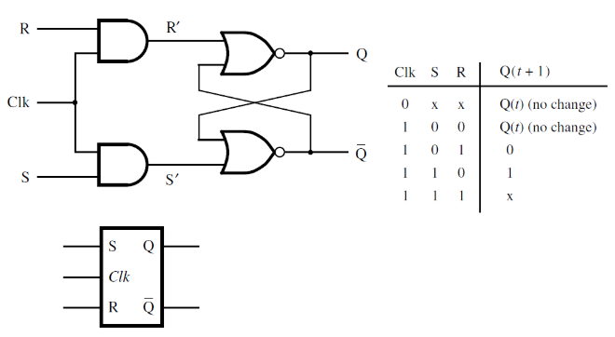
Gated (SR) Latch
EEE282
EEE283

Slide 11
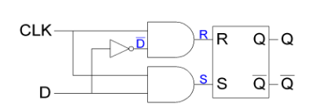
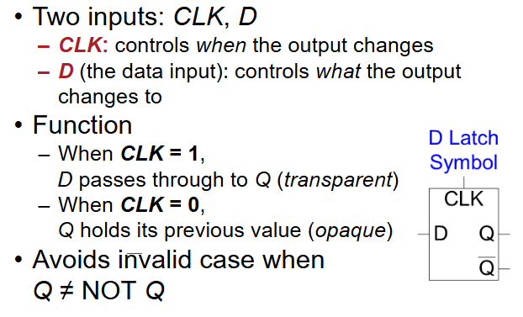
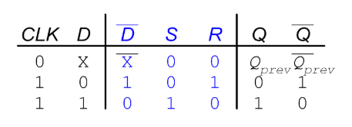
Gated D-Latch
EEE282
EEE283

Slide 12
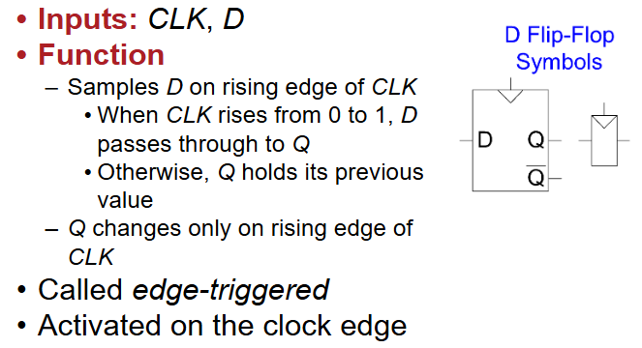
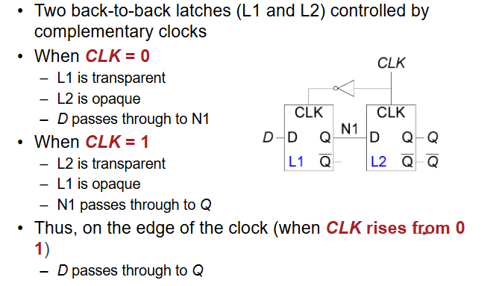
D-Flip Flop
EEE282
EEE283

Slide 13
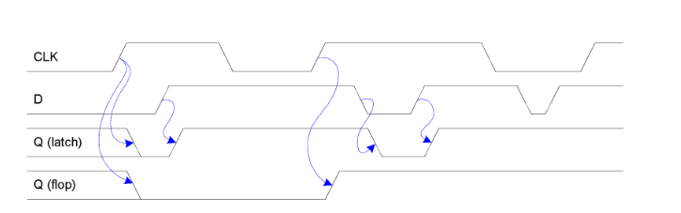
Timing Diagrams
EEE282
EEE283

Slide 14
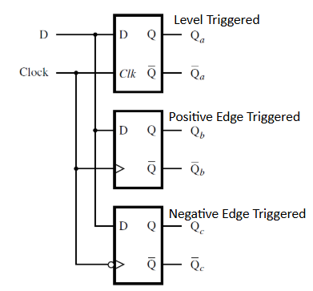
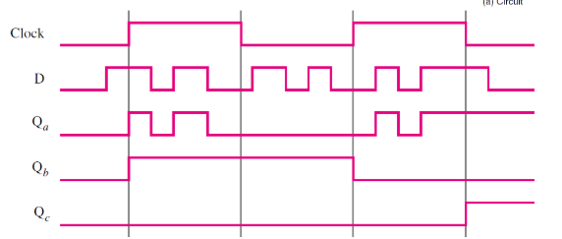
Triggering: Level vs Edge
EEE282
EEE283

Slide 15
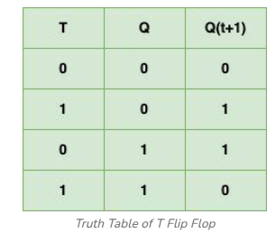
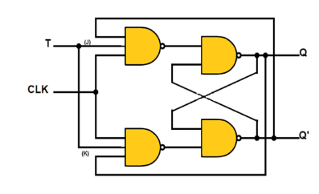
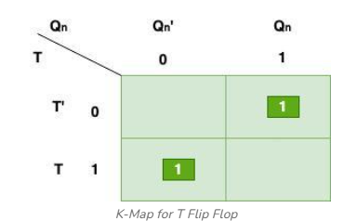
T- Flip Flop
Q(n+1) = TQn’ + T’Qn = T ⊕ Qn
EEE282
EEE283

Slide 16
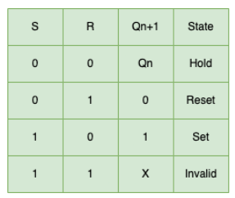
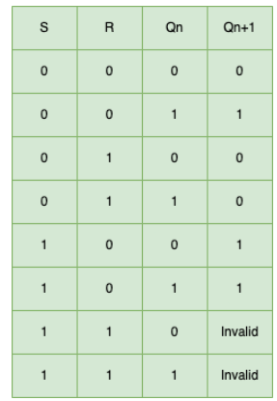
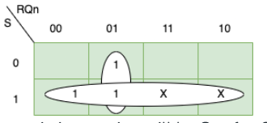
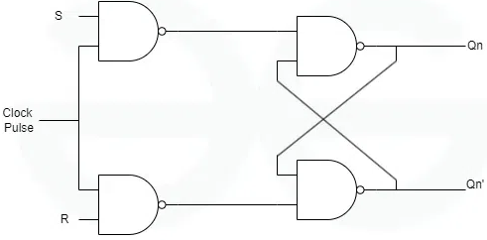
S-R Flip Flop
Q(n+1) = S+Q(n)R’
EEE282
EEE283

Slide 17
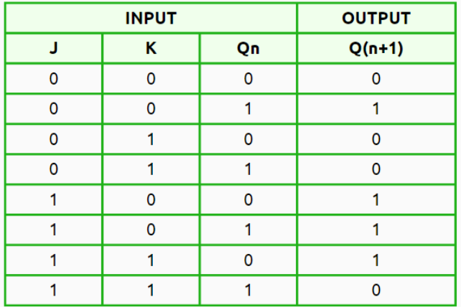
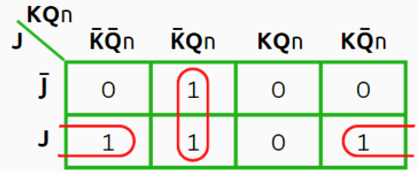

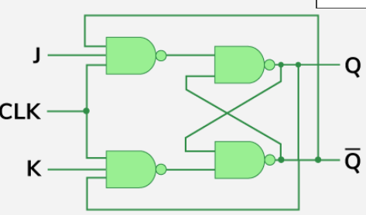
J-K Flip Flop
EEE282
EEE283

Slide 18
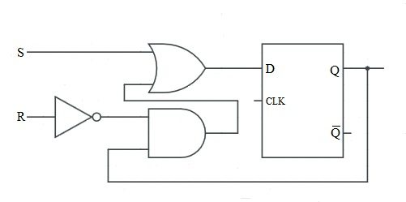
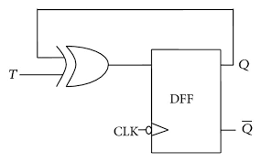
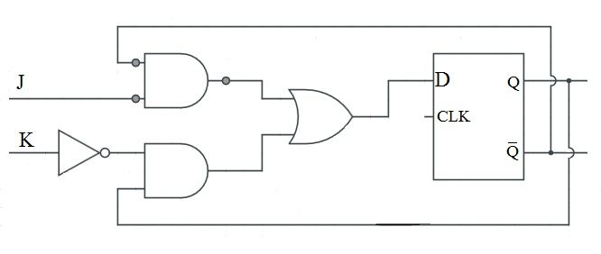
Building different FF from D-FF
SR-FF
T-FF
JK-FF
EEE282
EEE283

Slide 19
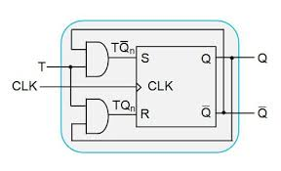
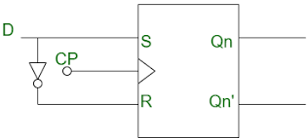
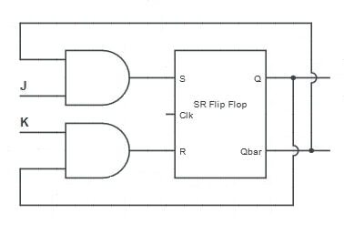
Building different FF from SR-FF
D-FF
T-FF
JK-FF
EEE282
EEE283

Slide 20
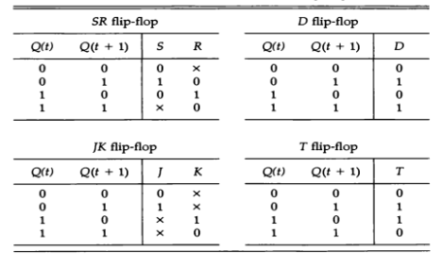
Excitation Table for Flip Flops
EEE282
EEE283

Slide 21
Flip-Flop Interconversion
Identify the available FF and required FF. For example: if you want to construct a T-FF using an SR-FF, your available FF is SR and required is T.
Construct the characteristic table of the required FF.
Construct the excitation table of the available FF.
Make a connection between the characteristic table and the excitation table.
Find a boolean expression for the inputs to the available FF.
EEE282
EEE283

Slide 22
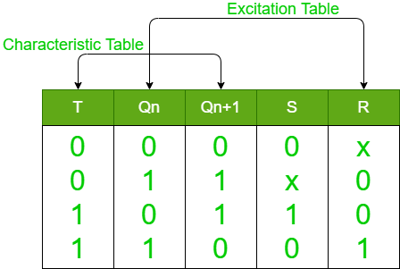
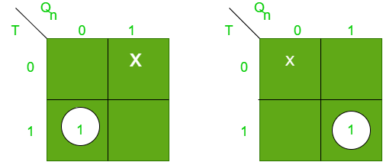
Flip-Flop Interconversion
EEE282
EEE283

Slide 23
Asynchronous Inputs
S-R, D and J-K inputs are synchronous inputs, as data on these inputs are transferred to the flip-flop’s output only on the triggered edge of the clock pulse.
Asynchronous inputs affect the state of the flip-flop independent of the clock; example: preset (PRE) and clear (CLR) [or direct set (SD) and direct reset (RD)]
When PRE=HIGH, Q is immediately set to HIGH.
When CLR=HIGH, Q is immediately cleared to LOW.
Flip-flop in normal operation mode when both PRE and CLR are LOW.
EEE282
EEE283

Slide 24
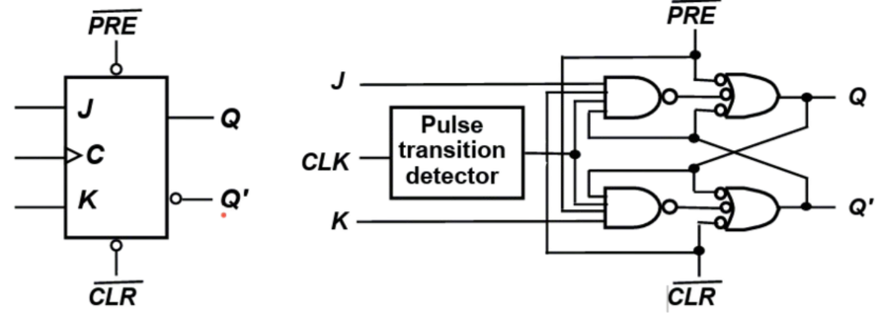
Asynchronous Inputs
EEE282
EEE283

Slide 25
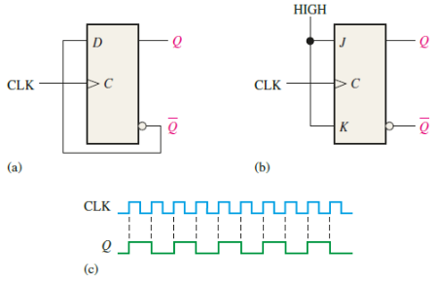
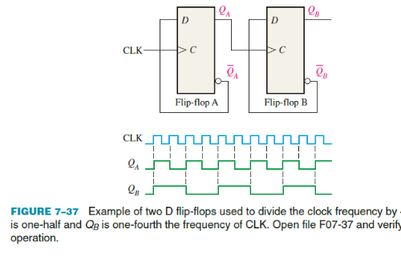
Application: Frequency Division
EEE282
EEE283

